Slide 1





Comprehensive Insurance Coverage for Denturists in BC
Presented to:
Wilson M. Beck Insurance Services
May 29th, 2025
Presented By:
Brett Nicholson, Managing Director
Garrett Buchfink, Life & Group Insurance Advisor

Slide 2





Our Team - Contact Information
Brett Nicholson
Managing Partner
Garrett Buckfink
Life & Group Insurance Advisor
250-617-4200
403-854-8047
778-693-2740
888-437-1100 (TF)
825-638-2200
888-437-1100 (TF)
bnicholson@wmbeck.com
gbuckfink@wmbeck.com
01

Slide 3

Agenda
Current Coverage - Mandatory Professional Liability
Professional Liability - Employees & Clinic
Additional Recommended Coverage - (CGL, Property, Business Interruption, Equipment Breakdown, Cyber Insurance, & Directors & Officers Liability.
Summary
Group & Individual Benefits
Questions
Wilson M. Beck Insurance Services
May 29, 2025
Comprehensive Insurance Coverage for Denturists in BC
02

Slide 4
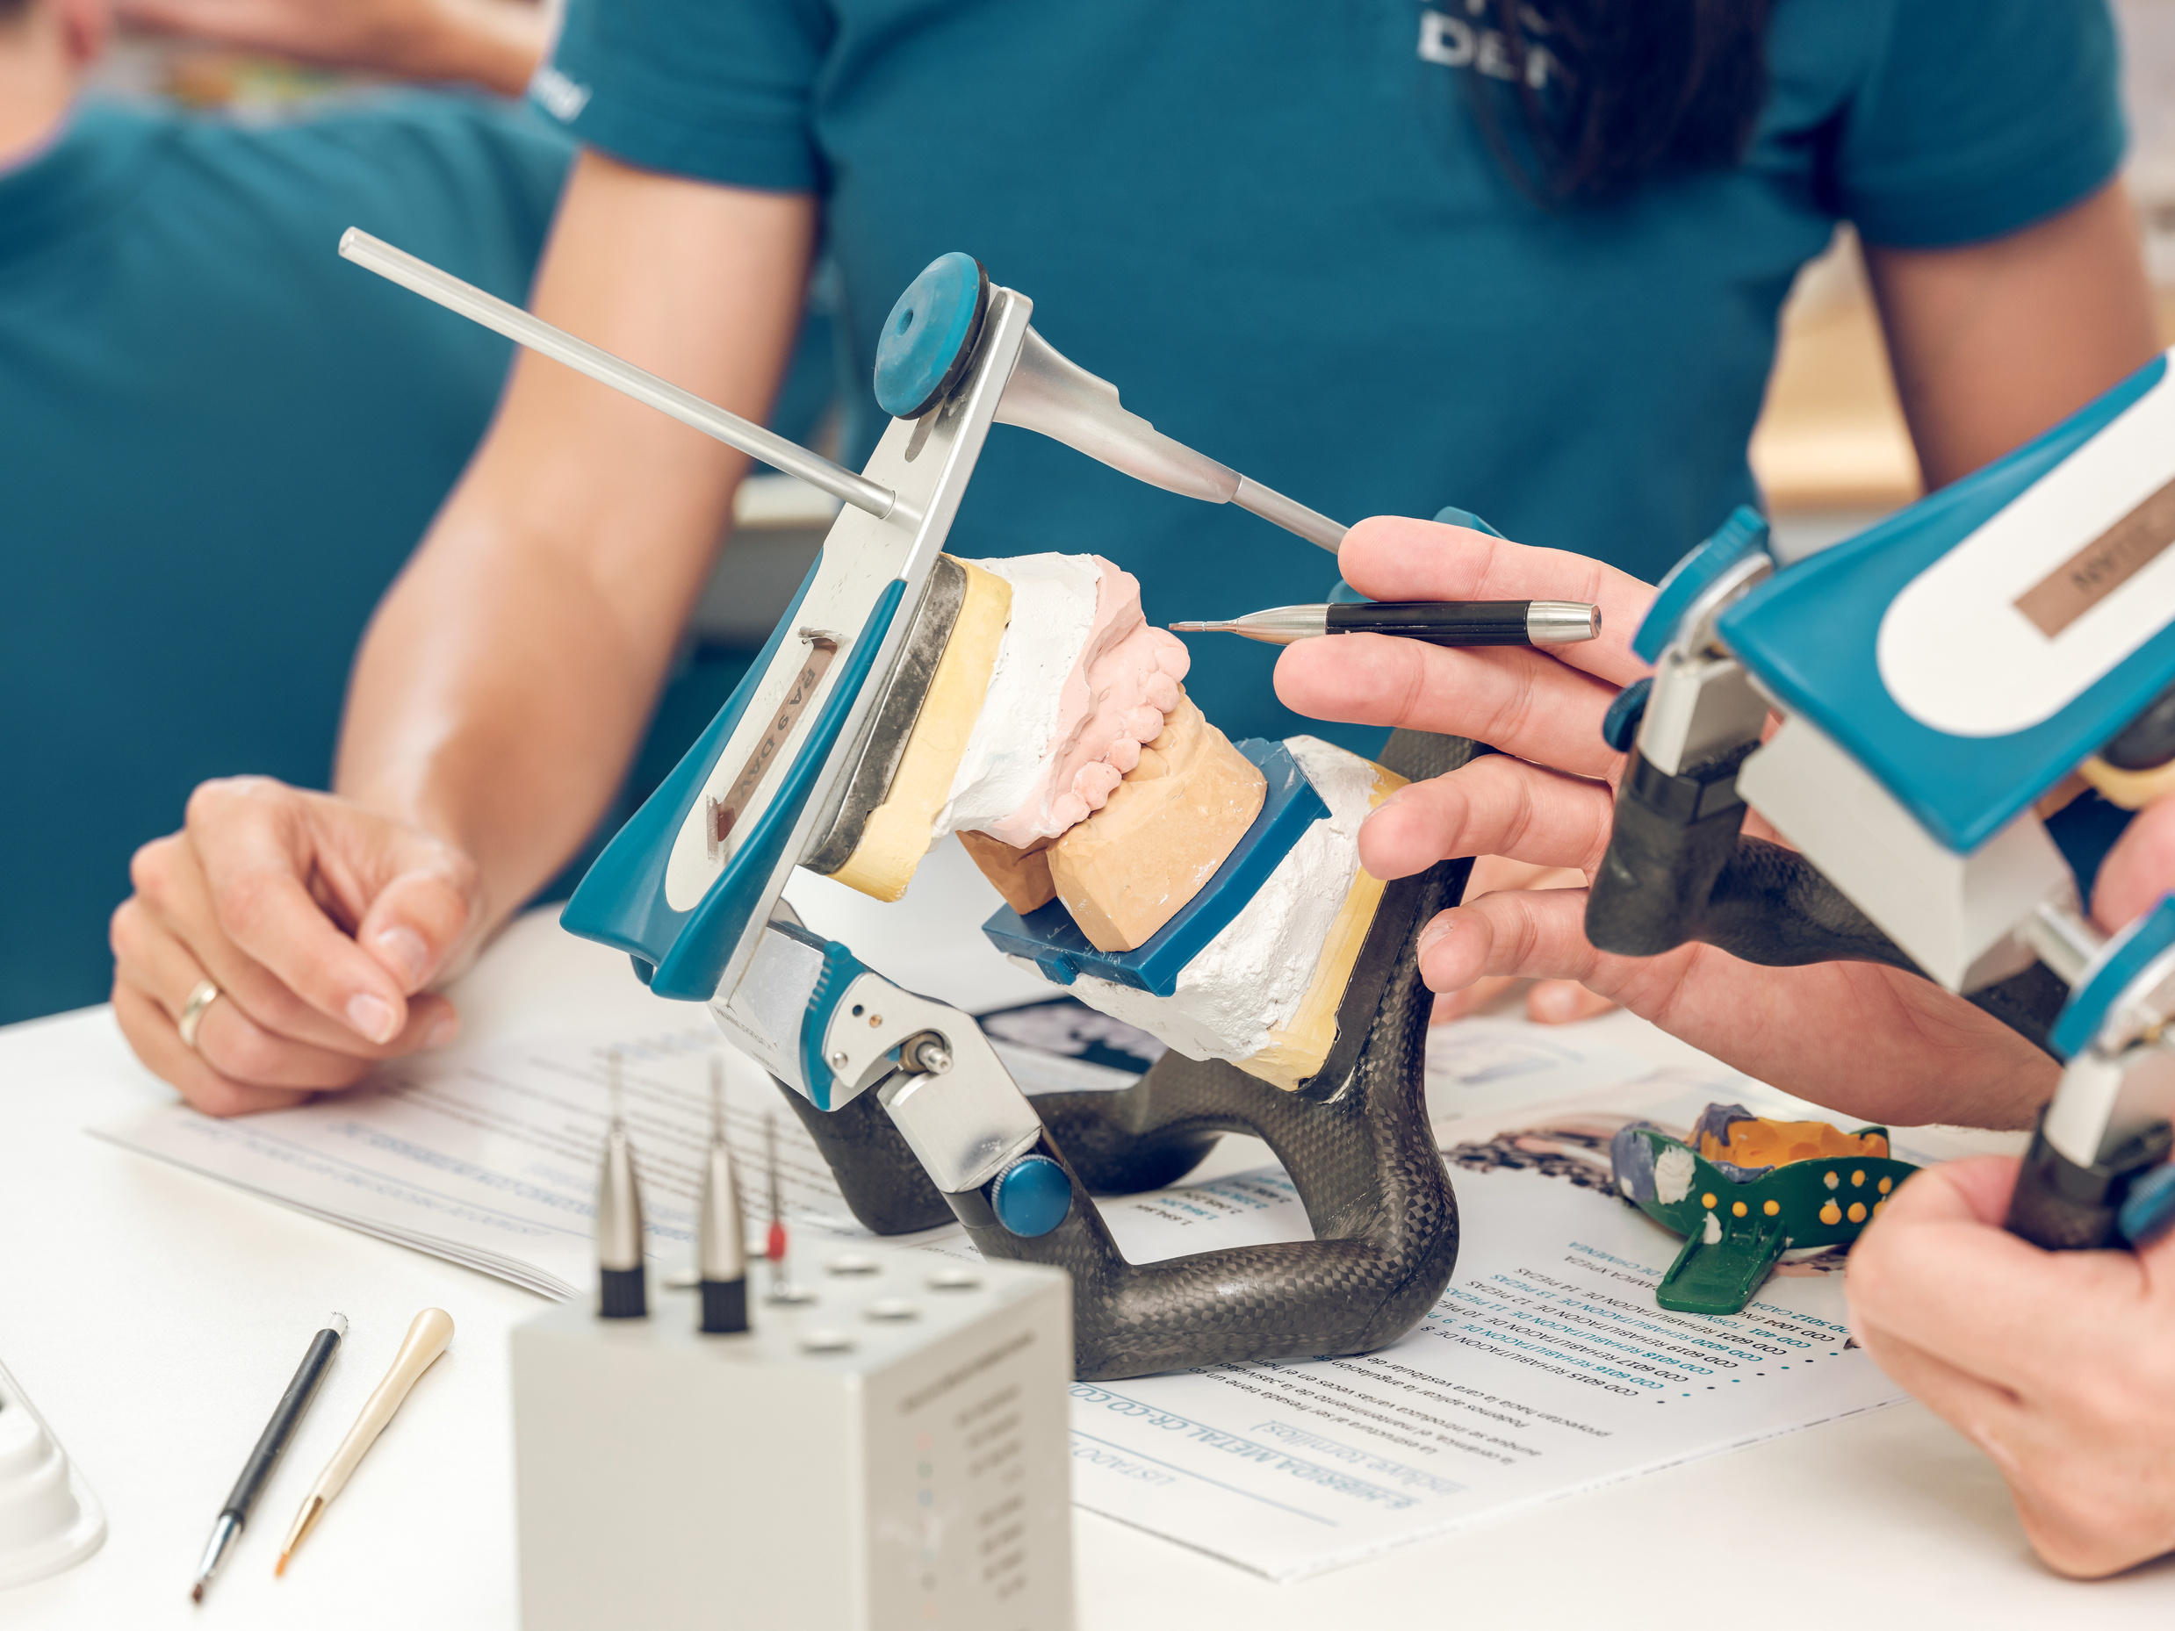
Introduction
We are proud to work with the Denturist Association, supporting their members with tailored insurance solutions that reflect the unique needs of oral health professionals. This experience has given us a deep understanding of the risks, challenges, and priorities that practitioners in the dental field face every day.
Wilson M. Beck Insurance Services
May 29, 2025
Comprehensive Insurance Coverage for Denturists in BC
03

Slide 5

Current Coverage
Mandatory Professional Liability
  Professional Liability Insurance is required for all practicing denturists in BC
  Mandated by the College of Denturists of BC as a condition of licensure
  Protects the individual practitioner from claims of:
    Professional negligence
    Errors or omissions in the course of treatment
  Required Minimum Coverage: $2 million per claim
  Must be maintained continuously, including during any leave or part-time status
Wilson M. Beck Insurance Services
May 29, 2025
Comprehensive Insurance Coverage for Denturists in BC
04

Slide 6

Professional Liability
Employees & Clinic
  Professional liability does not automatically extend to your clinic or staff
  Clinics and business entities can face lawsuits even if individual practitioners are insured
  Recommended coverage includes:
  Staff and associate denturists
  Reception, assistants, and other employees
  The clinic as a legal entity
  Protects against vicarious liability and shared fault
Wilson M. Beck Insurance Services
May 29, 2025
Comprehensive Insurance Coverage for Denturists in BC
05

Slide 7

Additional Recommended Coverage
Overview
Beyond the mandatory Professional Liability policy, clinics and denturists should consider:
  Commercial General Liability (CGL)
  Property Insurance
  Business Interruption
  Equipment Breakdown
  Cyber Insurance
  Directors & Officers (D&O) Liability
These protect the full scope of clinic operations and risk exposures.
Wilson M. Beck Insurance Services
May 29, 2025
Comprehensive Insurance Coverage for Denturists in BC
06

Slide 8

Commercial General Liability (CGL)
  Covers bodily injury or property damage to third parties not related to treatment
    Examples: Slip and fall in the waiting room, damage to a neighboring business
  Often required in commercial leases
  Protects against lawsuits unrelated to clinical work
Wilson M. Beck Insurance Services
May 29, 2025
Comprehensive Insurance Coverage for Denturists in BC
07

Slide 9

Property Insurance
  Protects your physical space, equipment, furniture, and inventory
  Covers perils like:
    Fire, theft, vandalism
    Water damage or storms
  Ensure coverage reflects full replacement cost of your assets
Wilson M. Beck Insurance Services
May 29, 2025
Comprehensive Insurance Coverage for Denturists in BC
08

Slide 10

Business Interruption
  Covers lost income when your clinic can’t operate due to an insured event
  Helps pay:
    Rent
    Staff wages
    Ongoing bills
  Can make the difference between temporary closure and permanent loss
Wilson M. Beck Insurance Services
May 29, 2025
Comprehensive Insurance Coverage for Denturists in BC
09

Slide 11

Equipment Breakdown
  Covers repair/replacement of critical clinic equipment due to mechanical failure
  Examples: Sterilizers, compressors, digital imaging systems
  Not included in standard property policies
  Reduces financial burden from unexpected outages
Wilson M. Beck Insurance Services
May 29, 2025
Comprehensive Insurance Coverage for Denturists in BC
10

Slide 12

Cyber Insurance
  Protects against digital threats such as:
    Ransomware
    Data breaches
    Privacy law violations
  Covers costs of:
    Notifying patients
    Fines and penalties
    System recovery
  Crucial with increased use of digital patient records and online systems
Wilson M. Beck Insurance Services
May 29, 2025
Comprehensive Insurance Coverage for Denturists in BC
11

Slide 13

Directors & Officers (D&O) Liability
  Applies if your clinic is incorporated or you sit on a board (e.g., professional associations)
  Covers personal liability of directors and officers for:
    Allegations of mismanagement
    Breach of fiduciary duty
    Employment practices lawsuits
  Helps attract and protect leadership roles
Wilson M. Beck Insurance Services
May 29, 2025
Comprehensive Insurance Coverage for Denturists in BC
12

Slide 14

Summary
  Denturists must carry Professional Liability as per College regulations
  All other coverages are strongly recommended to protect your business, assets, and reputation
  Clinics face multiple operational risks that require a comprehensive insurance approach
  Work with a broker who understands healthcare and clinic-based needs
Wilson M. Beck Insurance Services
May 29, 2025
Comprehensive Insurance Coverage for Denturists in BC
13

Slide 15
QUESTIONS
Let’s discuss your coverage needs.
Any questions? We’re here to help!
Contact
Wilson M. Beck Insurance Services Inc.
3685 Massey Drive, Prince George, BC V2N4E6
Brett Nicholson | (250) 617-4200 | bnicholson@wmbeck.com
www.wmbeck.com
@wmbinsurance
14

Slide 16
Group and Individual Benefits
Wilson M. Beck Insurance Services Inc.
Insurance 101 Seminar
March 6th, 2025
15

Slide 17
Agenda
Introduction
Disability Risk
Your Most Valuable Asset
Health and Dental
Final Tips & Takeaways
Wilson M. Beck Insurance Services
May 29, 2025
Comprehensive Insurance Coverage for Denturists in BC
16

Slide 18
What Your Health Benefits Include —
and How I Can Help
Life Insurance
Disability
Health and Dental
Critical Illness
Group Benefits
Estate Planning
Wilson M. Beck Insurance Services
May 29, 2025
Comprehensive Insurance Coverage for Denturists in BC
16

Slide 19
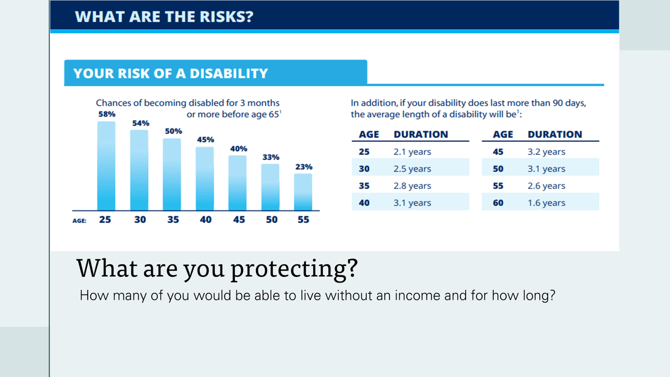
What are the risks?
Wilson M. Beck Insurance Services
May 29, 2025
Comprehensive Insurance Coverage for Denturists in BC
17

Slide 20
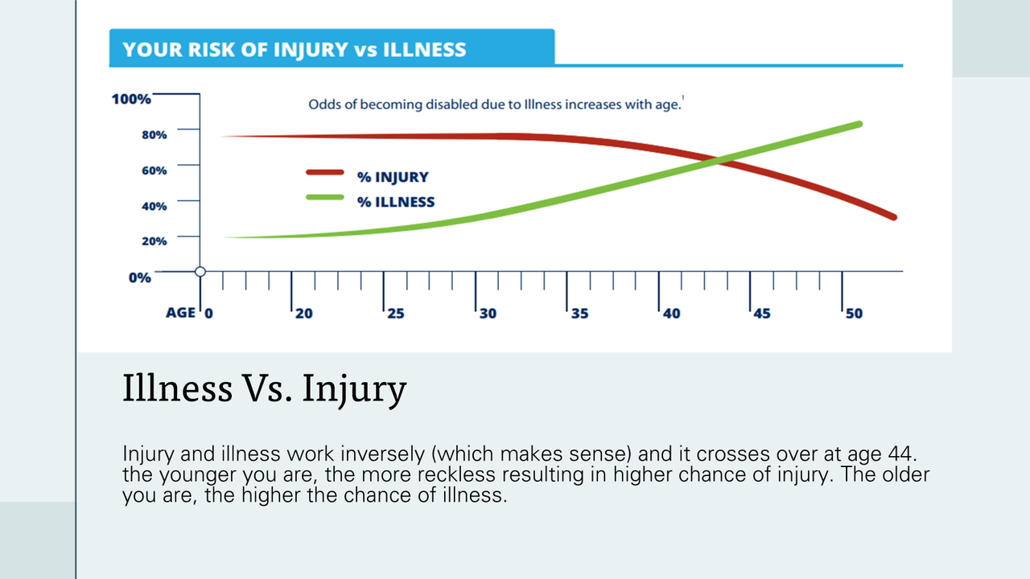
What are the risks?
Wilson M. Beck Insurance Services
May 29, 2025
Comprehensive Insurance Coverage for Denturists in BC
18

Slide 21
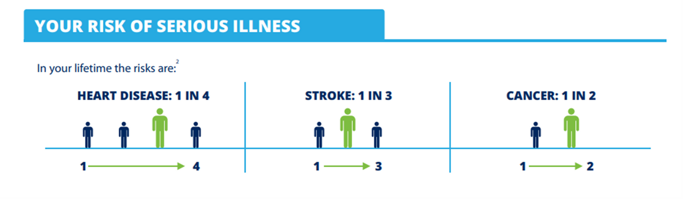
Why Illness Coverage?
These stats are shocking; Technology has people living longer, but this also means the chances of illnesses and conditions are substantially higher.
Wilson M. Beck Insurance Services
May 29, 2025
Comprehensive Insurance Coverage for Denturists in BC
19

Slide 22



What is your Most Valuable Asset?
Wilson M. Beck Insurance Services
May 29, 2025
Comprehensive Insurance Coverage for Denturists in BC
20

Slide 23
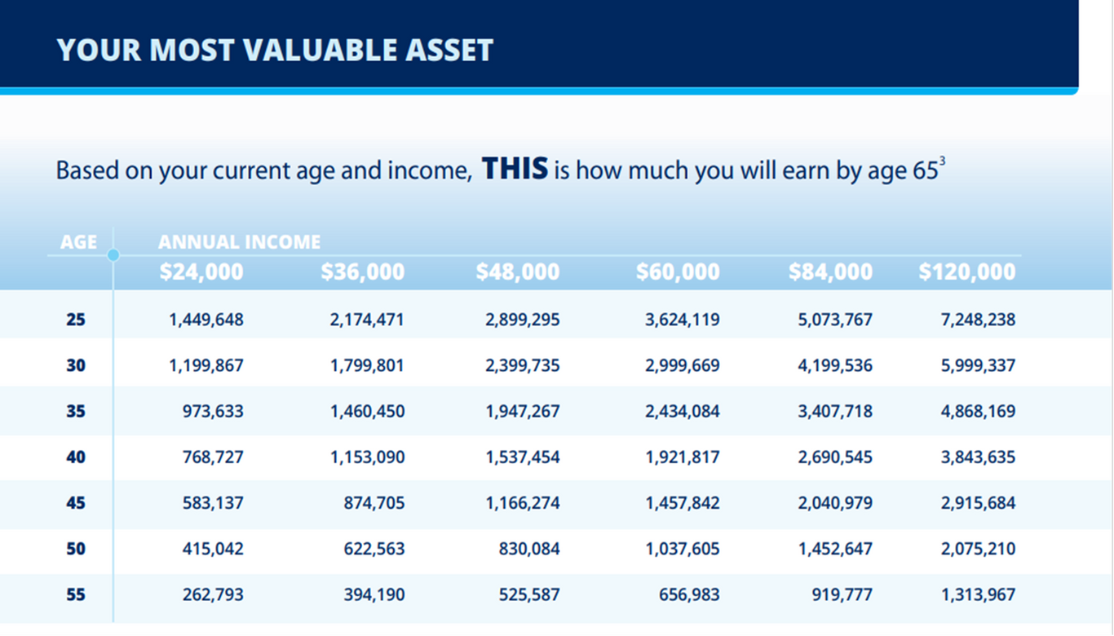
Your Most Valuable Asset
Wilson M. Beck Insurance Services
May 29, 2025
Comprehensive Insurance Coverage for Denturists in BC
21

Slide 24


Protecting your Most Valuable Asset
  Your ability to earn an income is your biggest asset. Your home, car, toys etc. - they all mean nothing if you can’t afford to keep them. Without the proper coverage you could be extremely exposed.
  Denturists fit under executive class for occupation, which means the cost to set up a plan ensuring your financial safety would be very affordable!
Wilson M. Beck Insurance Services Inc.
Insurance 101 Seminar
March 6th, 2025
22

Slide 25
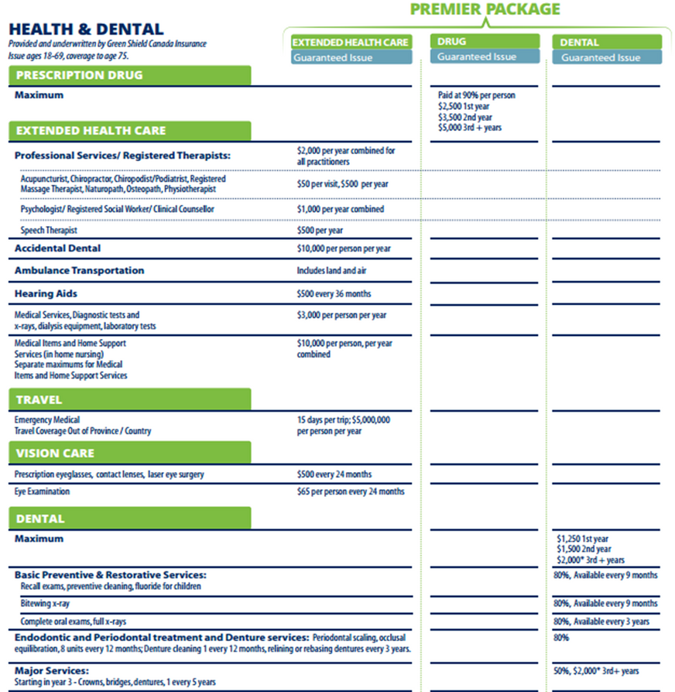
Health and Dental
A quick overview of our premier package, which is all guaranteed issue with NO underwriting!
Wilson M. Beck Insurance Services
May 29, 2025
Comprehensive Insurance Coverage for Denturists in BC
23

Slide 26

Getting Your Own Quote
Just click the Instant Quote button and you’ll immediately see the cost of your plan based on your age and family status. The application only takes a few minutes — and just a few clicks — to complete.
If you have questions or need support at any point, my contact info will be right there to help guide you.
One of the best parts? There’s no medical information required to qualify.
Nobody enjoys paying out of pocket for health expenses — this plan helps reduce those costs. And if you’re self-employed, your premiums may even be tax-deductible.
Wilson M. Beck Insurance Services
May 29, 2025
Comprehensive Insurance Coverage for Denturists in BC
24

Slide 27
Key Points and Takeaways
Health
and
Dental
Disability Coverage
Life Insurance
Financial Protection
Wilson M. Beck Insurance Services
May 29, 2025
Comprehensive Insurance Coverage for Denturists in BC
25

Slide 28
QUESTIONS
Let’s discuss your coverage needs.
Any questions? We’re here to help!
Contact
Wilson M. Beck Insurance Services Inc.
3685 Massey Drive, Prince George, BC V2N4E6
Garrett Buchfink | (403) 854-8047 | gbuchfink@wmbeck.com
www.wmbeck.com
@wmbinsurance
26

